Slide 1
DIGITAL LOGIC · COMBINATIONAL CIRCUITS
8-to-3
Priority Encoder
Eight request lines enter. One winning input becomes a three-bit code.

Slide 2
THE CORE IDEA
One output code, eight possible requests
A priority encoder is a combinational circuit with 8 inputs and 3 binary outputs.
8
3
1
request inputs
encoded outputs
winning request
The circuit reports the binary index of the highest-priority active input. Unlike a basic encoder, it produces a defined result when several inputs are active.

Slide 3
PRIORITY RULE
Priority decides which input is seen
Assume active-high inputs Y7…Y0: Y7 has highest priority and Y0 lowest. X marks lower-priority inputs that no longer affect the result.
Input | A2 | A1 | A0 | V
Y7 | 1 | 1 | 1 | 1
Y6, Y7=0 | 1 | 1 | 0 | 1
Y5, Y7…Y6=0 | 1 | 0 | 1 | 1
Y4, Y7…Y5=0 | 1 | 0 | 0 | 1
Input | A2 | A1 | A0 | V
Y3, Y7…Y4=0 | 0 | 1 | 1 | 1
Y2, Y7…Y3=0 | 0 | 1 | 0 | 1
Y1, Y7…Y2=0 | 0 | 0 | 1 | 1
Y0, Y7…Y1=0 | 0 | 0 | 0 | 1
None | – | – | – | 0
V = 1 when any input is active; V = 0 when all inputs are 0.

Slide 4
FROM PRIORITY TO LOGIC
Boolean equations turn priority into gates
Mask each lower input with the condition that every higher input is inactive.
MASKED WINNERS
OUTPUT OR-PLANES
P7 = Y7
P6 = ¬Y7 · Y6
P5 = ¬Y7 · ¬Y6 · Y5
P0 = ¬Y7 · ¬Y6 · ¬Y5 · ¬Y4 · ¬Y3 · ¬Y2 · ¬Y1 · Y0
A2 = P7 + P6 + P5 + P4
A1 = P7 + P6 + P3 + P2
A0 = P7 + P5 + P3 + P1
V = Y7 + Y6 + Y5 + Y4 + Y3 + Y2 + Y1 + Y0
NOT gates create the masks. AND gates identify one winning input. OR gates combine winners into A2A1A0 and V.

Slide 5

A LIVE REQUEST BUS
How the encoder works in real time
Monitor all eight request lines.
Block every input below the highest active request.
Pass the winning input's 3-bit binary code to the outputs.
Raise V so the next circuit knows the code is meaningful.
WORKED EXAMPLE
Y6 = 1 and Y2 = 1
Y6 wins, so A2A1A0=110 and V=1.

Slide 6
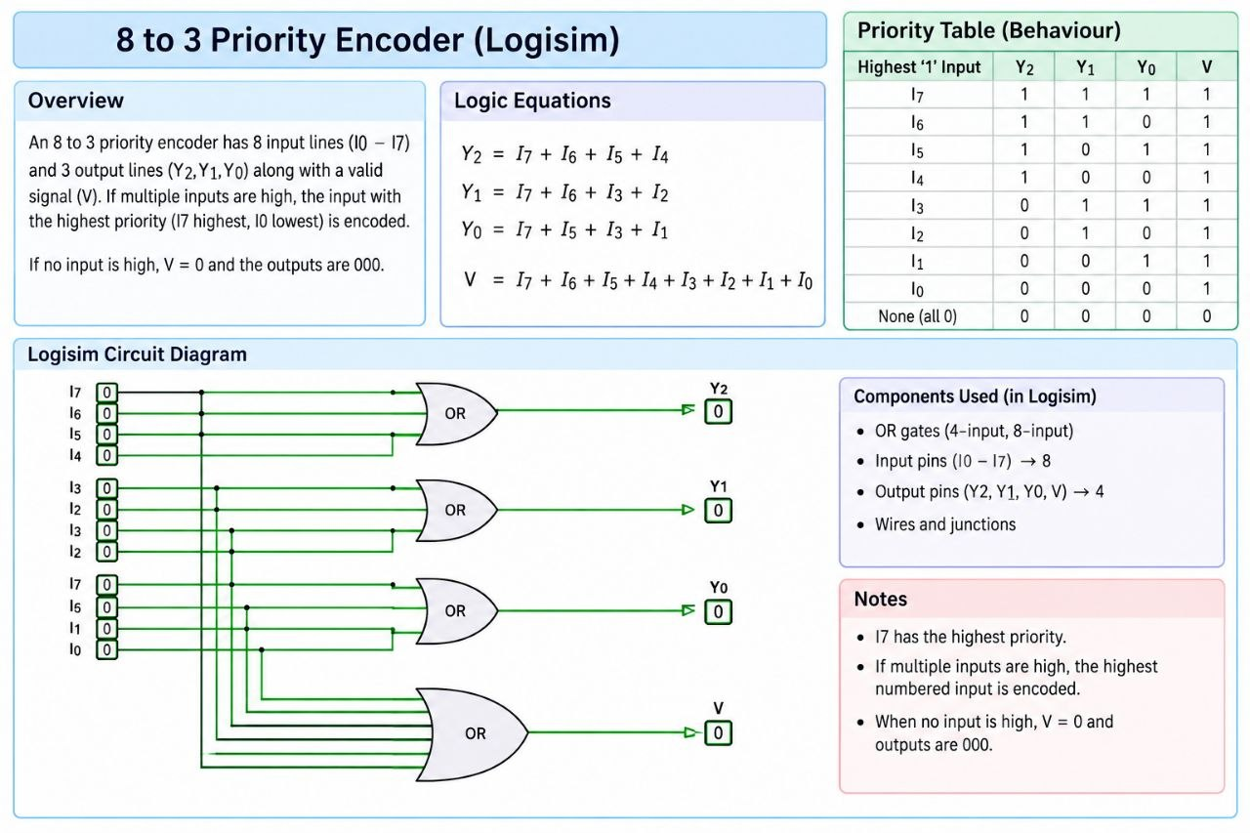

Slide 7
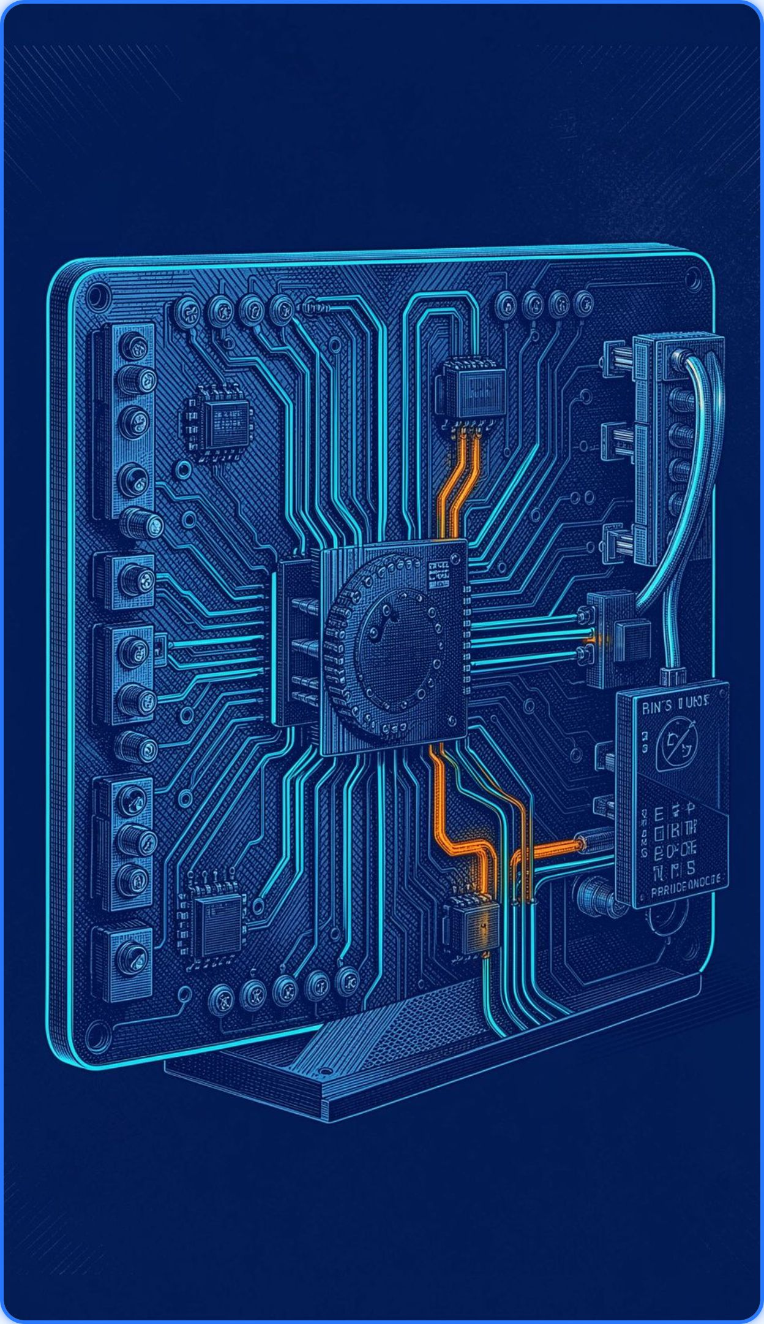




WHY IT MATTERS
Where priority encoders are useful
Interrupt controllers
Bus arbitration
Service the most urgent request first.
Choose one requester when several devices compete.
Keyboard and switch scanning
CPU and embedded control logic
Convert one active line into a compact code.
Reduce many request lines to a small encoded interface.

Slide 8
Thank you
2620040029 - MAHITHA CHOWDARY
2620040030 - DHARANI KOLASANI
2620030695 - SUHAS REDDY
2620040031 - SYANTHANA PRIYA

